Slide 1
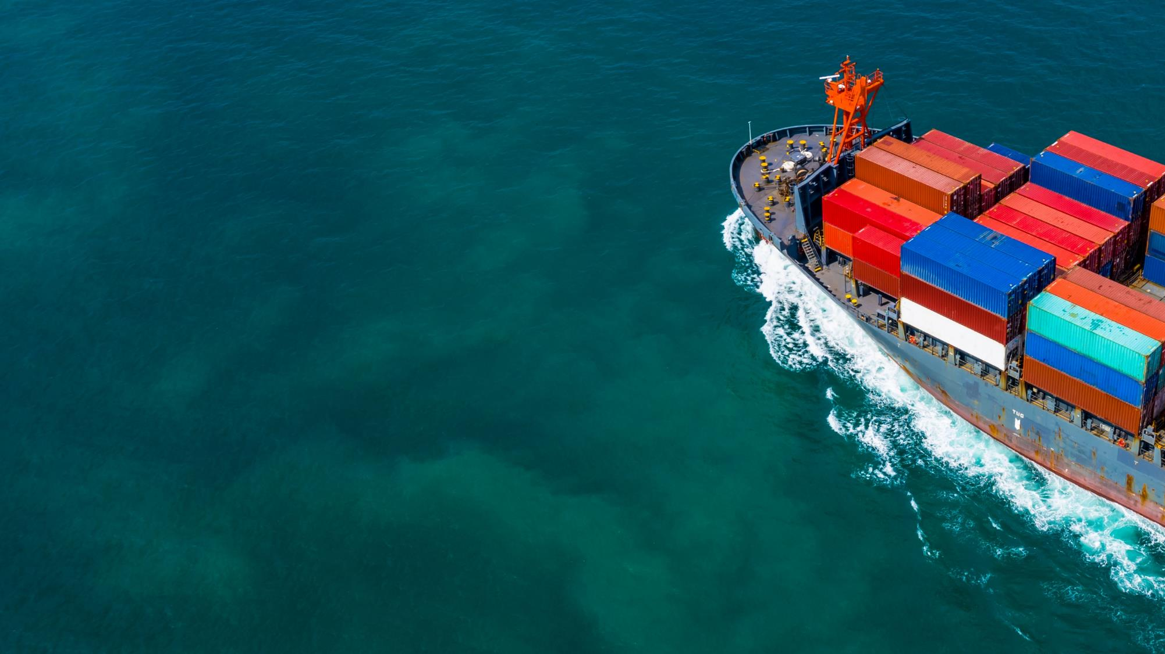

UK Export Finance
Competitive finance when you buy from the UK
Daniel Rathwell
Head, UKEF Qatar & Oman

Slide 2
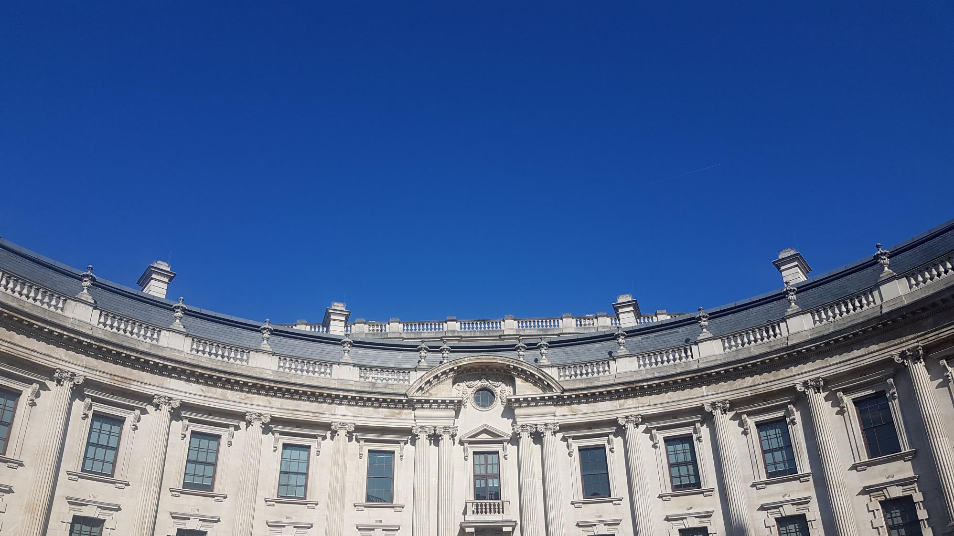
Mission
We advance prosperity by ensuring no viable UK export fails for lack of finance or insurance, doing that sustainably and at no net cost to the taxpayer.

Slide 3



About UK Export Finance
The world’s first export credit agency, established in 1919
Competitively priced finance in return for accessing world class UK supply chain
We support UK businesses that export, through:
  Providing export insurance to UK exporters
  Providing overseas buyers with finance for projects that include UK content
  Providing support to UK exporters for working capital financing
Winner of multiple awards, including TXF Perfect 10 Deals of the Year, GTR Best Deal Awards, and Sustainable ECA of the Year 2021 (GTR)

Slide 4

UKEF in Oman
A long-standing partner
Country limit:
£4b
        Part of strong UK-Oman relationship, underpinned by new sovereign investment partnership
        Support for Oman’s Vision 2040 objectives prioritised…
        …including clean growth and economic transition
A strong track record:
2012: Typhoon and Hawk: £2b
2016: Liwa Plastics Industrial Complex: $157m
2019: Duqm Refinery: £700m
Current market risk appetite:
£1-2b
Regional/market representative based in Doha
Notes:
*To be used for overseas audience (buyers/project sponsors)

Slide 5


Our products
Buyer finance: attractive long-term financing (2-10+ years) to overseas buyers. Credit guarantee, clean growth direct lend and others. 20% UK content minimum – and support to achieve this.
Exporter guarantee: guarantees of up to 80% of the value of a bank loan. Contract specific or general.
Insurance: Insurance against non-payment.

Slide 6
Our Commitment to Clean Growth

Slide 7
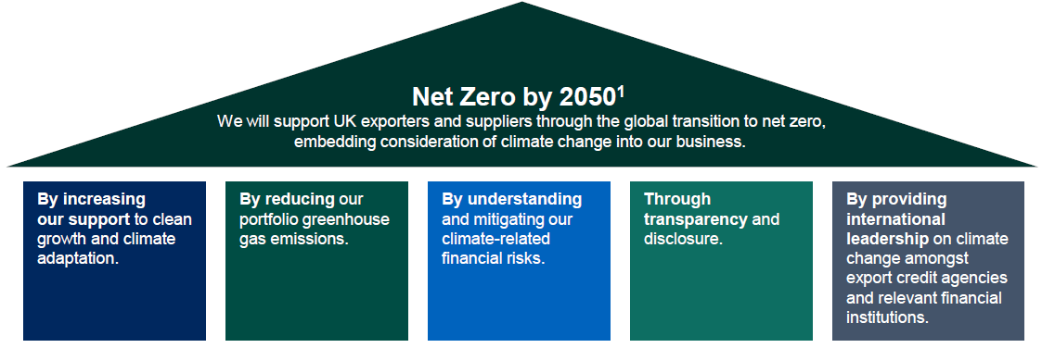
UKEF’s Clean Growth Strategy
£3.6b clean growth projects financed (2021) – 50% up from 2020
Ended support for new fossil fuels projects
Assessing and mitigating climate risks in existing portfolio and new deals
Will report against climate commitments
COP26: helped secure agreement with 39 other ECAs to end new fossil fuel support
Notes:
https://www.gov.uk/government/news/ukef-supports-major-hospital-construction-in-ivory-coast

Slide 8
Clean Growth Direct Lending Facility
Additional £2 billion to support clean growth projects overseas
The UK Clean Growth Strategy defines clean growth as “growing our national income while cutting greenhouse gas emissions”
Eligibility for the Clean Growth DLF will be based on the UK Clean Growth Strategy description as well as the internationally recognised Green Bond Principles
Projects under the Clean Growth DLF benefit from the same commercial terms as projects financed under the general Direct Lending Facility – long tenor periods, attractive rates.

Slide 9







Clean growth: eligible projects
Sustainable water and wastewater management
Clean transportation
Climate change adaption
Renewable energy
Terrestrial and aquatic biodiversity conservation
Green buildings
Eco-efficient and/or circular economy adaption
Energy efficiency
Environmentally sustainable management
Pollution prevention and control

Slide 10
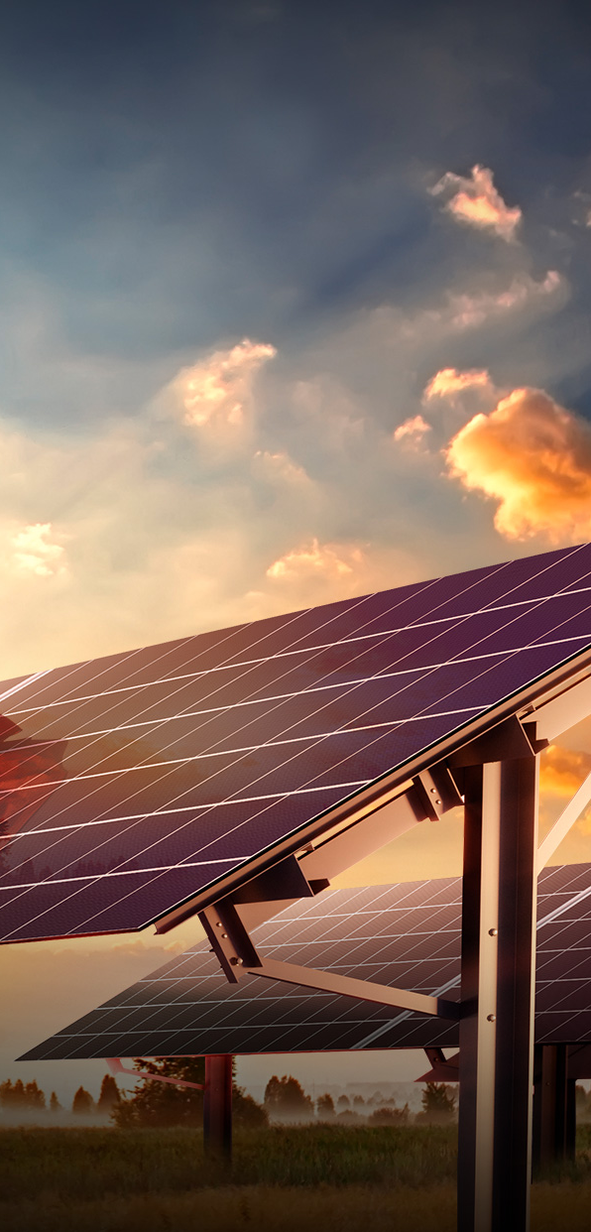
Examples
Turkey: Karapinar Solar: £250m UKEF financing to construct Turkey’s largest solar facility, able to power more than 2 million homes.
This is the largest solar transaction in Turkey and one of the largest in the world. UK content driven by GE.
Taiwan: Greater Changhua 1 Offshore Wind Farm: £200m UKEF financing to construct a 605MW offshore wind farm.
UK content included shipping/transportation, cable protection systems, etc.
UKEF has now provided £500m financing for 3 offshore wind farms in Taiwan.

Slide 11
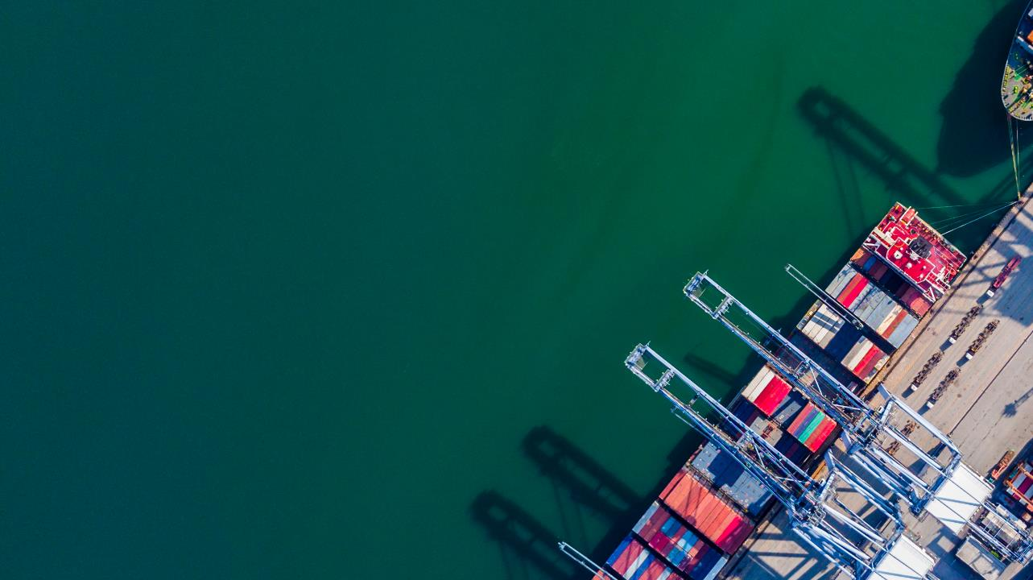
Thanks and feel free to get in touch.
Daniel.rathwell@fcdo.gov.uk

